Slide 1
Capstone Project
Netflix Movie and TV Shoes Clustering
Team Members:
Rohan Dhunde

Slide 2

Content
Introduction
Problem Statement
Data Description
Dataset Summary
EDA (Exploratory Data Analysis
Data Cleaning
Data Pre-Processing
Ml Model Implementation
Model 1: Kmeans
Model 2: Cluster Analysis

Slide 3
Introduction
Netflix is a media distribution company that has undergone significant changes over time
Originally, Netflix focused on distributing DVDs through mail
Today, Netflix is primarily focused on streaming video content
Netflix offers a mix of licensed and original content, with some produced in-house
While movies were the original focus, television shows are now more common on the platform
Netflix operates on a subscription model, providing unlimited access to content for paid subscribers

Slide 4
Problem Statement
The problem statement of this project is to explore and analyze the Netflix dataset to identify patterns and similarities among TV shows and movies. The goal is to cluster the content into groups of similar shows and movies using attributes such as director, cast, country, genre, rating, and description. Additionally, the project aims to integrate external datasets like IMDB ratings and Rotten Tomatoes to provide insights into the content's quality and popularity. The ultimate objective is to build a content-based recommendation system that provides personalized recommendations to users based on their viewing behavior and preferences, ultimately enhancing the user experience on the Netflix platform..

Slide 5
Data Description
This dataset consists of tv shows and movies available on Netﬂix as of 2019. The dataset is collected from Flixable which is a third-party Netﬂix search engine
show_id : Unique ID for every Movie / Tv Show
type : Identiﬁer - A Movie or TV Show
title : Title of the Movie / Tv Show
director : Director of the Movie
cast : Actors involved in the movie / show
country : Country where the movie / show was produced
date_added : Date it was added on Netﬂix
release_year : Actual Release Year of the movie / show
rating : TV Rating of the movie / show
duration : Total Duration - in minutes or number of seasons
listed_in : Genre
description: The Summary description

Slide 6
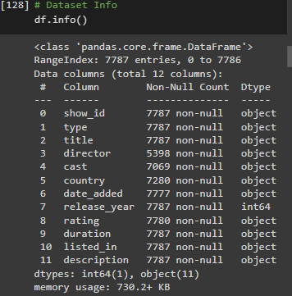
Dataset Summary
Our dataset consists of 12 columns and 7787 rows.
We have identified the following columns with null values:
  director (30.68%)
  cast (9.22%)
  country (6.51%)
  date_added (0.13%)
  rating (0.089%)
We will drop the null values in date_added and rating since they are very few.
To extract more information from date_added, we will do some feature engineering:
  Convert date_added into a datetime variable
  Extract year_added, month_added, and day_added from the datetime variable.
These new variables will provide us with more information about when the content was added to the platform.

Slide 7
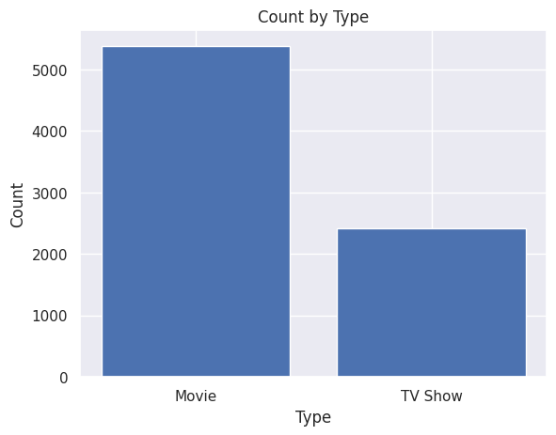
EDA (Exploratory Data Analysis)
According to the dataset, there are more movies than TV shows.
The bar plot shows that the dataset consists of 5377 movies and 2410 TV shows.
This means that the dataset has almost two times more movies than TV shows.
The distribution of movies and TV shows in the dataset is an important factor to consider when analyzing the data.
Let's take a closer look at the characteristics of movies and TV shows in the dataset to gain more insights.

Slide 8

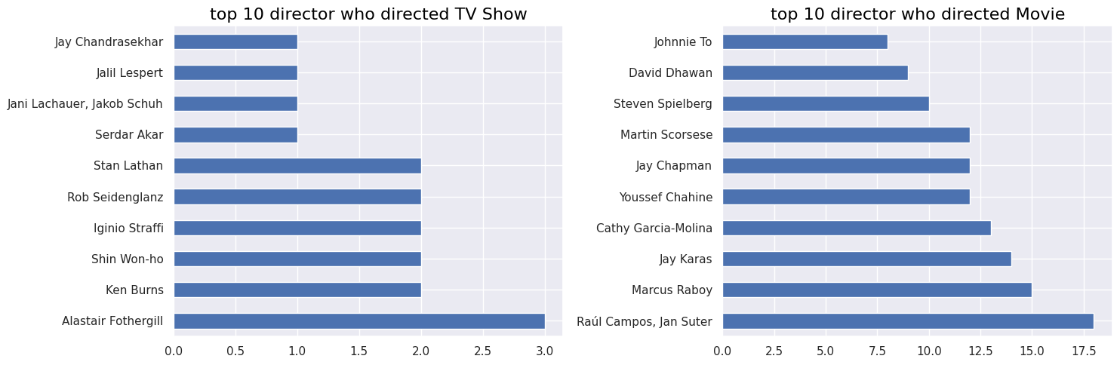
Top 10 direcrors who directed Movie & TV shows
The highest number of TV shows directed by any director in the dataset is three, and this distinction belongs to Alastair Fothergill.
The director pair Raul Campos and Jan Suter have collaborated directed 18 movies, which is the highest number compared to any other director pair in the dataset. They are followed by Marcus Raboy, Jay Karas, and Cathy Garcia-Molina.

Slide 9
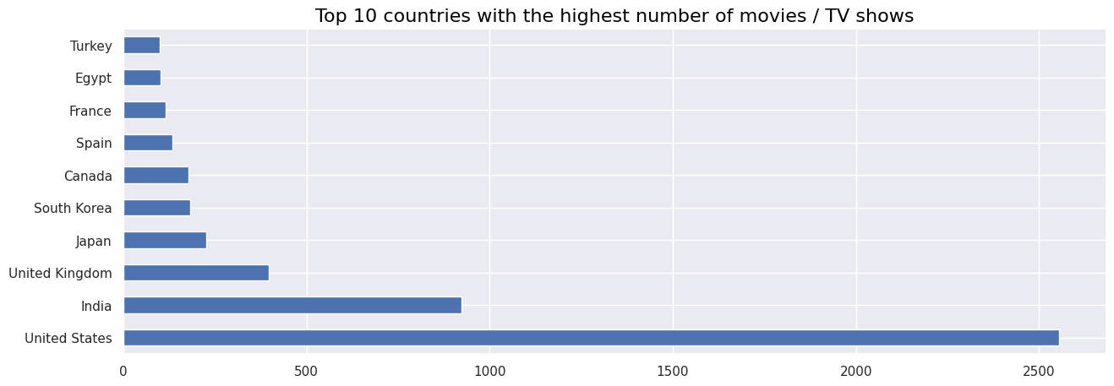
Top 10 Contries with the highest numbers of the Movies/Tv Shows
The highest number if Movies/ Tv Shows were based out US,fllowed by INDIA and UK

Slide 10
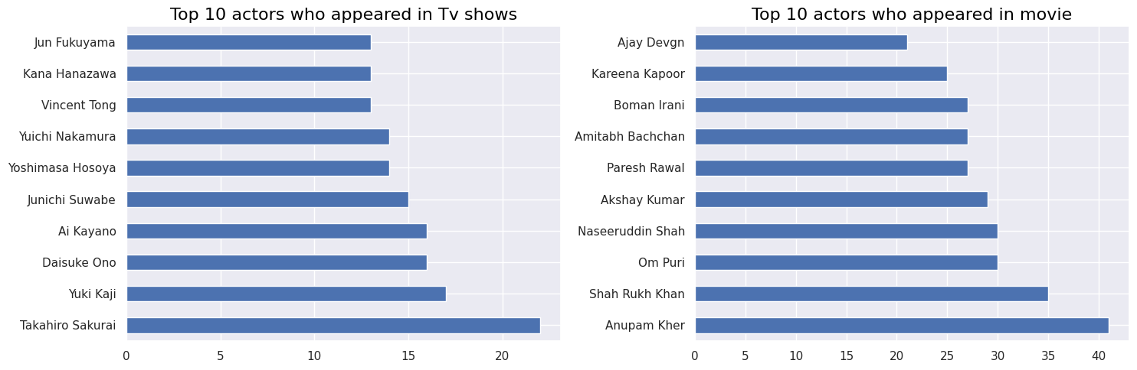
Top 10 actors who appeared in Tv shows/ Movies
Takahiro Sakurai, Yuki Kaji and Daisuke Ono played highest role in the TV shows.
Anupam Kher, Shahrukh Khan and Om Puri played highest number of role in the movies.

Slide 11
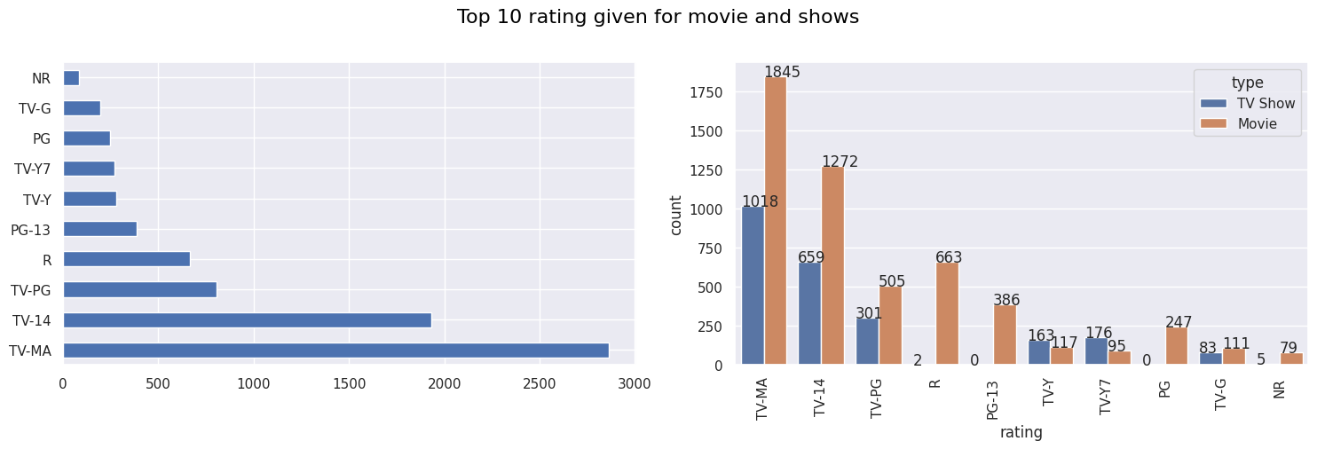
Top 10 rating given for Movie and Tv shows
The most of the movies and tv shows have of TV-MA then followed by TV-14

Slide 12
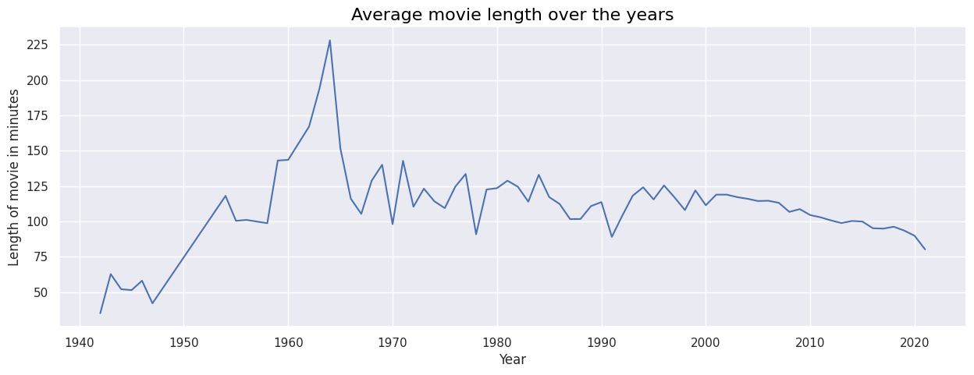
Average Movie Length Over The Years
Netflix offers a range of movies on its platform, including those from as far back as 1942.
Movies made in the 1940s had a relatively short duration, according to their plots.
On average, movies made in the 1960s are the longest in length.
The average length of movies has been decreasing steadily since the 2000s.

Slide 13
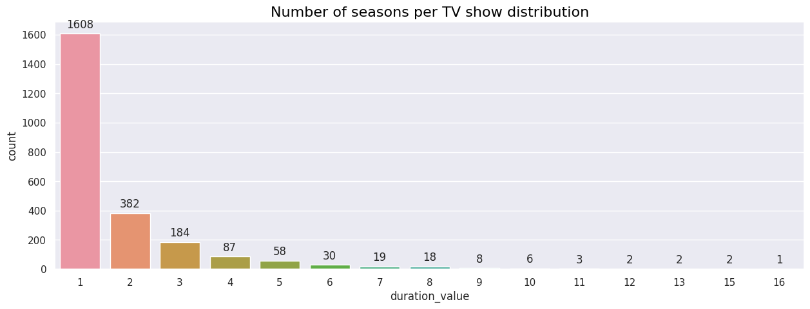
Numbers of seasons per TV shows distribution
The TV series in the dataset have a maximum of 16 seasons, but the majority only have one season.
This could suggest that many of the TV shows are relatively new and additional seasons may be in the works.
There are very few TV shows in the dataset with more than 8 seasons.

Slide 14
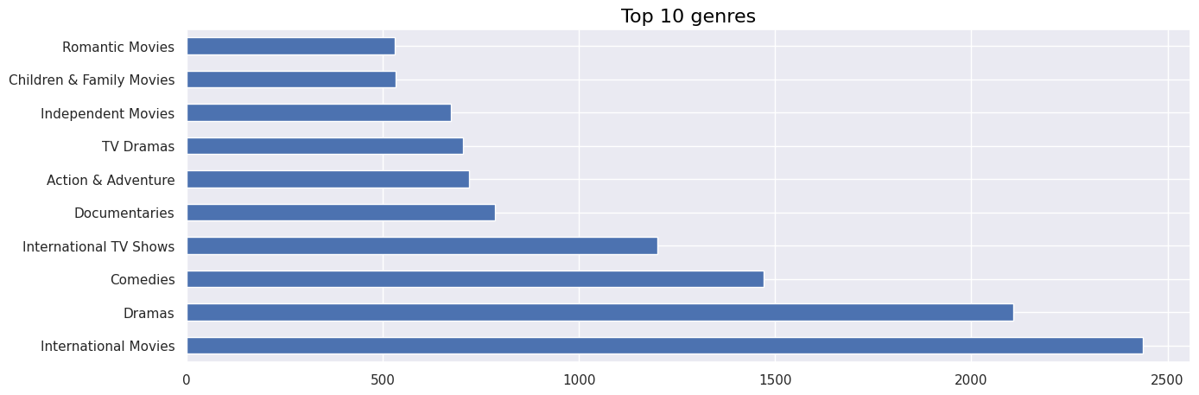
Top 10 genres
Most of the comman words present in description column are family, find, life, love, new, world, friend.

Slide 15
Feature Engineering & Data Pre-processing

Slide 16
Data Cleaning
Removing non-ASCII characters:
Removing stopwords and lower case:
Removing Punctuation:
Stemming:
Tf – idf Vectorization:

Slide 17
Data Preprocessing
To preprocess the text data, we removed all punctuation and stopwords from the text. We also applied stemming to the words in the text, which reduced them to their base form with singular meaning.
Next, we used the TF-IDF vectorizer to vectorize the text data. This process assigned a numerical value to each word in the text based on its frequency and importance in the entire corpus of reviews.
To reduce the dimensionality of the text data, we performed Principal Component Analysis (PCA), which is a technique that transforms high-dimensional data into a lower-dimensional space while preserving most of the variance in the data.
Overall, our preprocessing and analysis of the text variable allowed us to identify important patterns and trends in the customer reviews, which could be used to inform business decisions and improve the product.

Slide 18
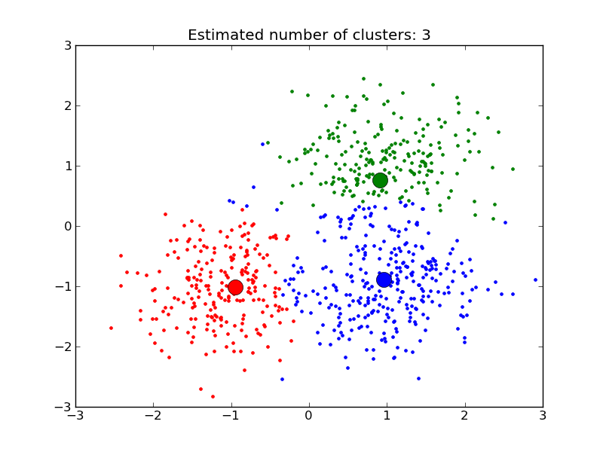
Clusters:
Clustering is a popular machine learning technique used to group similar data points together. The primary objective of clustering is to divide a dataset into a number of groups, such that the data points within each group are more similar to one another than they are to data points in other groups.
One of the most commonly used clustering algorithms is K-Means Clustering. This is an iterative process that involves grouping a dataset into k number of pre-defined non-overlapping clusters or subgroups. The algorithm works by making the inner points of the cluster as similar as possible, while also trying to keep the clusters at a distinct space.
K-Means clustering allocates the data points to a cluster so that the sum of the squared distance between the cluster centroid and the data point is at a minimum. This process is repeated iteratively until the centroids of the clusters no longer move or until a pre-defined number of iterations is reached.
Clustering can be useful in a variety of applications, including customer segmentation, image segmentation, and anomaly detection. By identifying groups of similar data points, clustering can help businesses make informed decisions and gain insights into patterns and trends within their data.

Slide 19
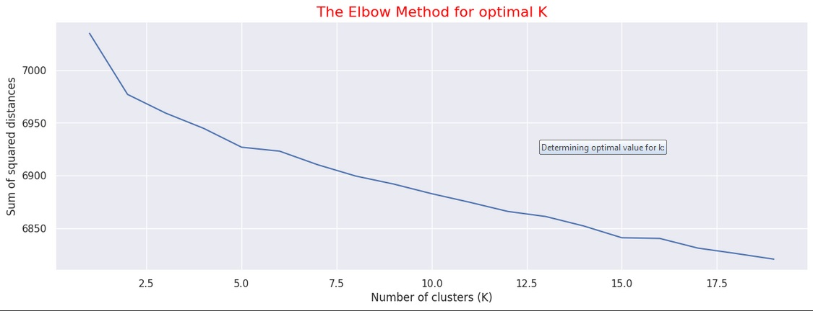
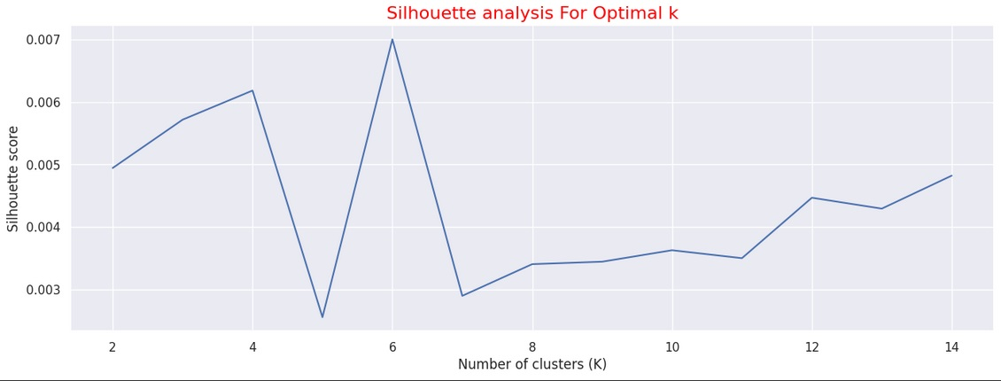
Determining optimal value for k:
Using the Silhouette Score and Elbow Method we select the optimal number of clusters to be 10.

Slide 20
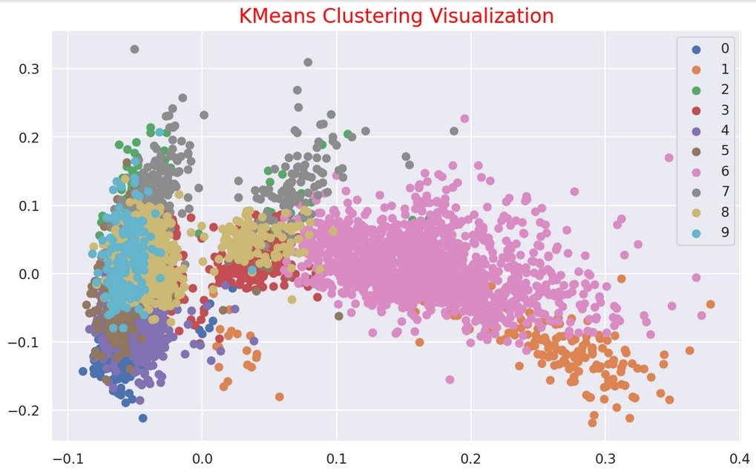
10 District Cluster created using Kmeans
Clustering
The numbers 0 to 9 represent 10-distinct clusters formed by K-means clustering.
Each cluster contains data points similar to those in the same groups but varies from other groups

Slide 21
Model 1: K-Means
To process the learning data, the K-means algorithm in data mining starts with a first group of randomly selected centroids, which are used as the beginning points for every cluster, and then performs iterative (repetitive) calculations to optimize the positions of the centroids
It halts creating and optimizing clusters when either:
The centroids have stabilized — there is no change in their values because the clustering has been successful.
The defined number of iterations has been achieved

Slide 22
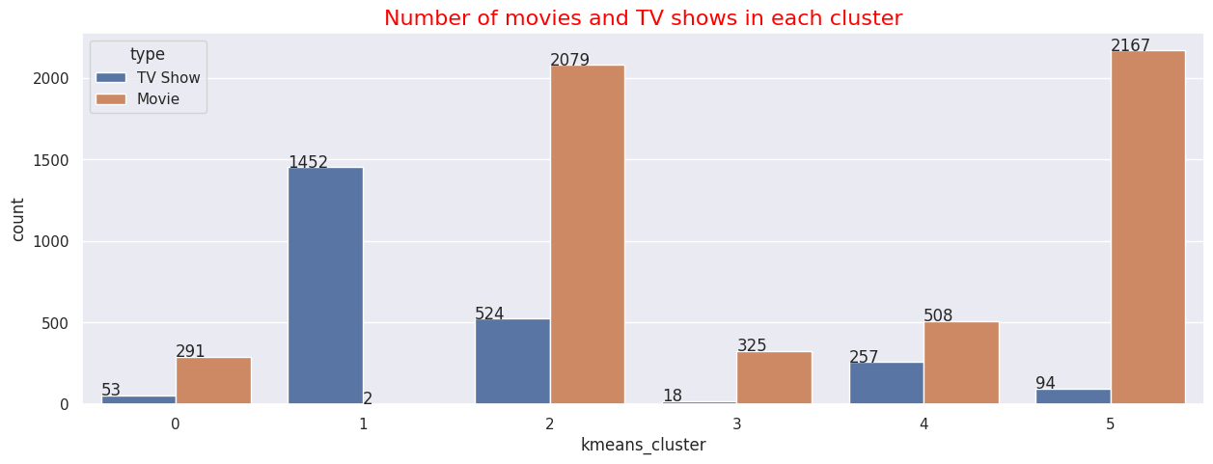
Numbers pf Movies and Tv shows in each Cluster
Successfully built 6 clusters using the k-means clustering algorithm.

Slide 23
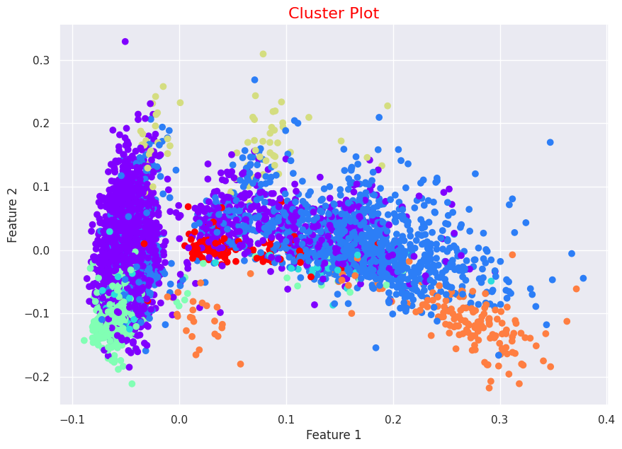
Model 2: Hierachical Clusters
agglomerative clustering is a powerful approach for cluster construction, providing insights into the data's structure. The algorithm's hierarchical nature allows for the identification of distinct groups and relationships. By leveraging the visualization of the dendrogram, we can make informed decisions regarding the optimal number of clusters to use in our analysis.
Agglomerative clustering provides valuable insights into the structure of our data.
The algorithm helps identify distinct groups and relationships within the dataset.
By leveraging the scatter plot visualization, we can make informed decisions about the number of clusters to use.

Slide 24
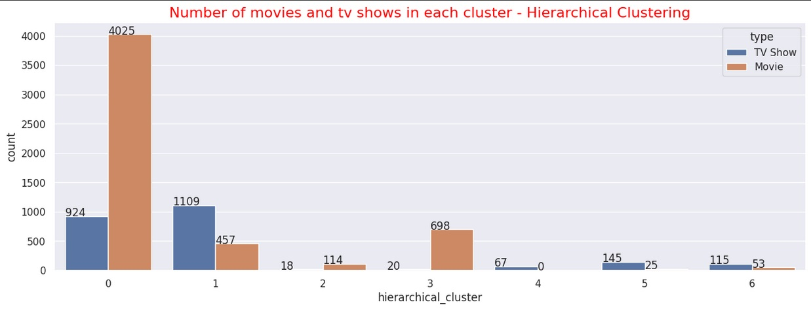
Hierarchical Clusters
The Agglomerative (hierarchical) clustering algorithm was utilized to construct 7 clusters successfully.

Slide 25


Word Cloud of hierarchical clusters
Wordcloud for cluster 0
# Wordcloud for cluster 2

Slide 26
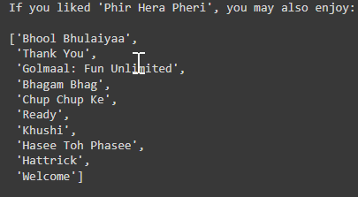
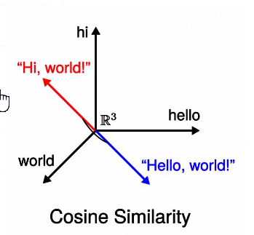
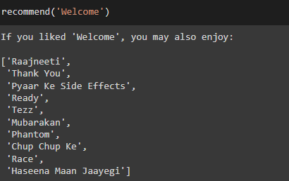
Recommendations:
We obtained recommendations for Movies and Tv- Shows using Cosine similarity.

Slide 27
Conclusion:
The dataset contained 7787 records and 11 attributes. Exploratory data analysis was performed, and missing values were handled.
Netflix has more movies than TV shows, and the number of shows on the platform is growing rapidly. Most shows are produced in the United States.
The data was clustered based on attributes such as director, cast, country, genre, rating, and description. Tokenization, preprocessing, and vectorization were performed using TFIDF Vectorizer, resulting in 10,000 attributes.
Dimensionality reduction was performed using Principal Component Analysis (PCA), with 4,000 components capturing over 80% of variance.
K-Means Clustering was used to build the initial clusters, with the optimal number of clusters being 6 as determined by the elbow method and Silhouette score analysis.
Agglomerative clustering was used to create clusters, with 7 being the optimal number determined by visualizing the dendrogram.
A content-based recommender system was developed using cosine similarity on the similarity matrix. The recommender system recommends the top 10 shows based on the type of show the user has watched.

Slide 28
Thank You

